Slide 1
Welcome to Famli!
Empowering you to enhance student wellbeing and learning, both in and out of school

Slide 2
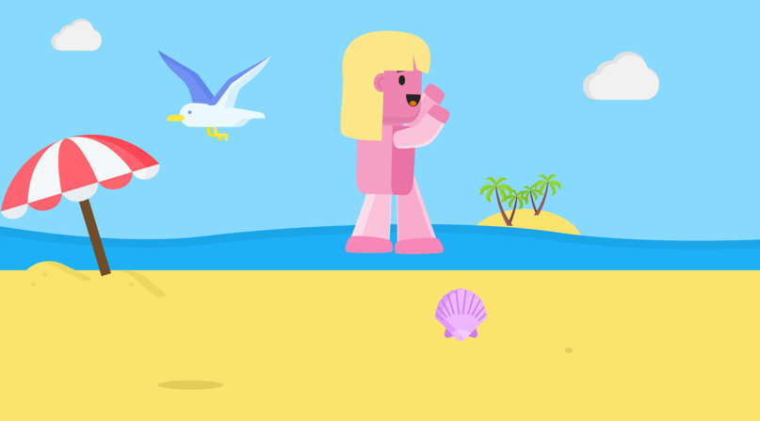
Elevate your students’ readiness to learn
Everything you need to improve the wellbeing and academic success of your students, all in one place.
Provide a fun and engaging experience
Receive positive impact data
Access ready-to-use wellbeing brain breaks, designed to energise or calm your students so that they’re ready to learn.
All brain breaks and activities are gamified to engage students and support their learning in class and at home.
Evidence your impact on student wellbeing from usage in school and with families.

Slide 3
Elevating your students’ readiness to learn
Famli will help you build the optimal class environment for your students to learn and thrive

Slide 4
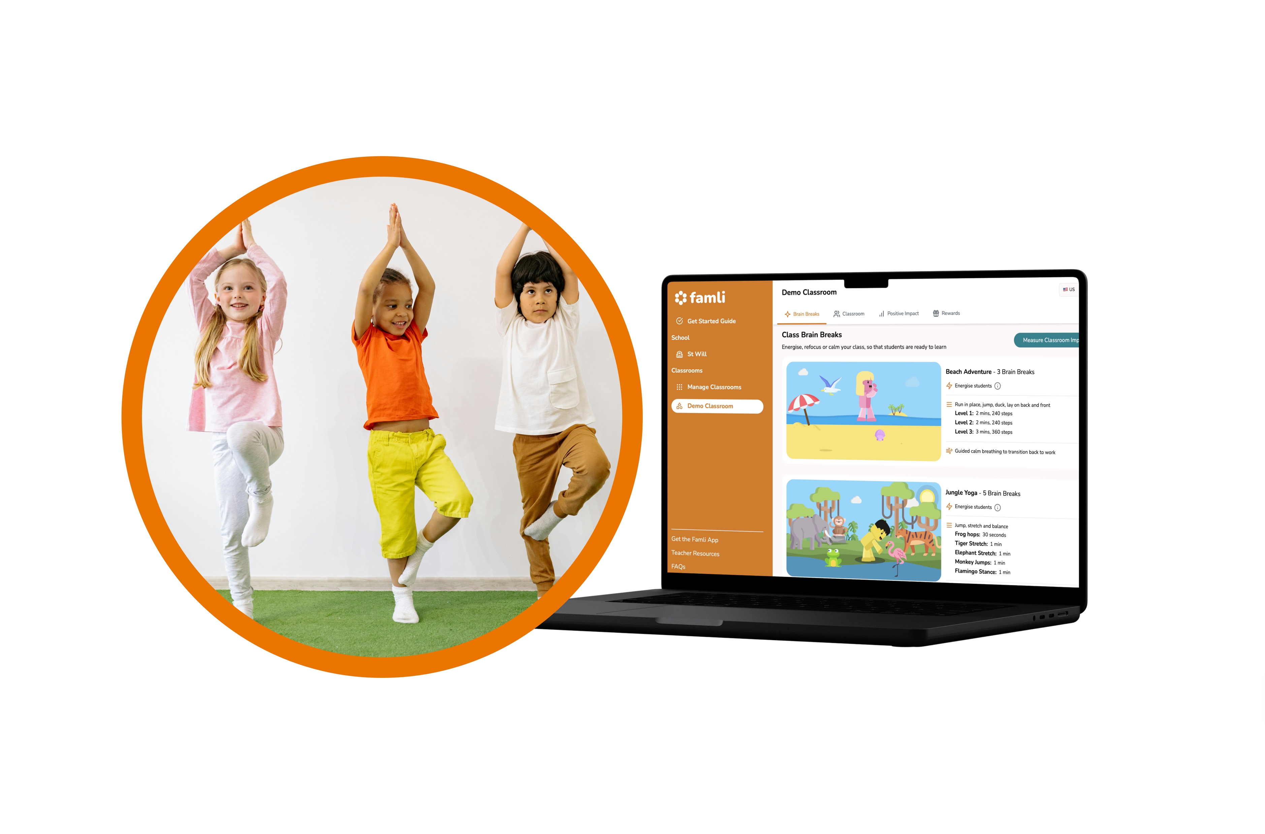
Famli Teacher Portal
Benefit from research-backed brain breaks to boost your class’s attention and focus.
Energise, calm and refocus your class
Fun, interactive and engaging for students
Requires no preparation or training
Can be displayed on a large screen
Teachers report up to a 40% increase their class’s focus after Famli brain breaks.

Slide 5
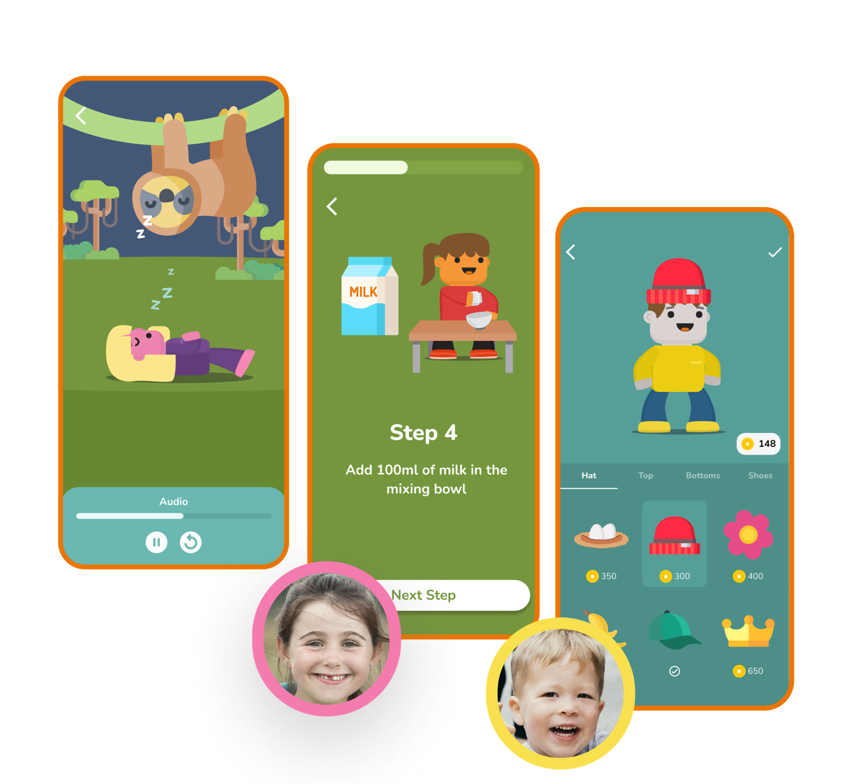
The Famli App
Provide further wellbeing support to individual students both in school and at home.
Alongside the class brain breaks in the Famli portal:
The Famli app has a variety of wellbeing activities that can be used in school on a 1 to 1 basis to support the wellbeing of individual students during the school day.
The Famli app can also be accessed at home by students that have a device and want use it further with their family.
School
Home
Portal
App
Note: Not all children will have access to a device and be able to use the app at home, hence the Famli app is only meant to act as an additional way to provide wellbeing support where possible.

Slide 6
Providing a fun and engaging experience
Famli will help you to promote the wellbeing of your students in a way that motivates and resonates with them

Slide 7
Gamification
Famli’s content engages students, helping you build a fun learning experience.
Famli’s brain breaks, and app activities are gamified and engaging, designed to increase attention and learning
Students can earn coins for various rewards when completing class brain breaks and app activities, to further boost engagement and motivation
Students will have fun while feeling supported with their overall wellbeing both in your class and at home
Data shows 100% of children report feeling more positive after using Famli

Slide 8
Measuring your positive impact
Famli will evidence the wellbeing impact you have on your students

Slide 9
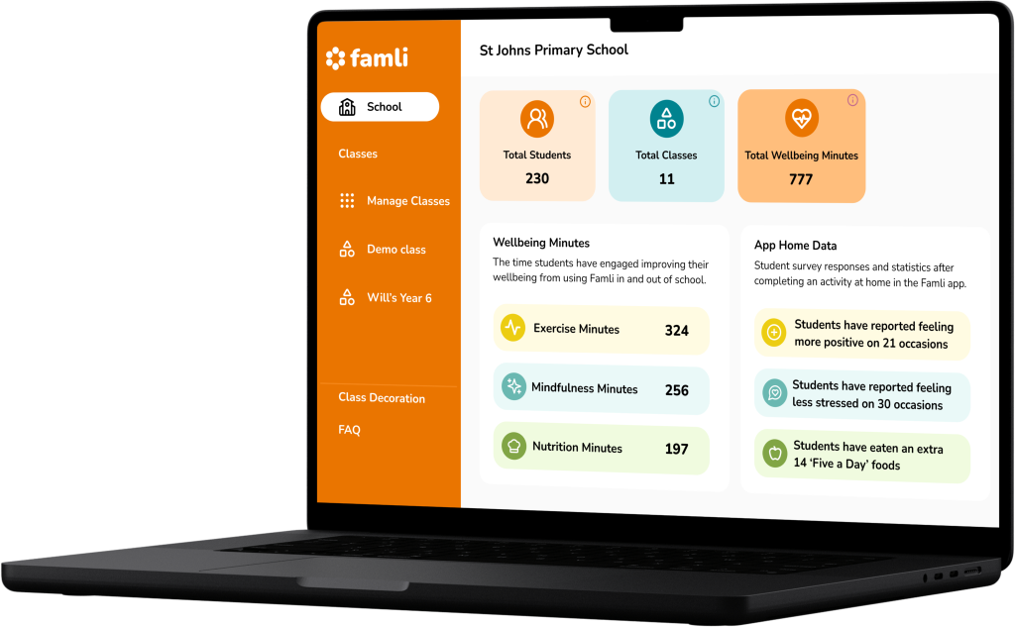
Positive Impact Data
Using the Famli teacher portal, you will be able to see your positive impact on students’ wellbeing.
For each class, you will see:
The number of exercise minutes contributing to the recommended 30 minutes a day
The number of mindfulness minutes contributing towards reduction of stress
The number of nutrition minutes and 5 a day contributing towards healthy eating habits
Data reporting how the students have used the Famli mobile app at home

Slide 10
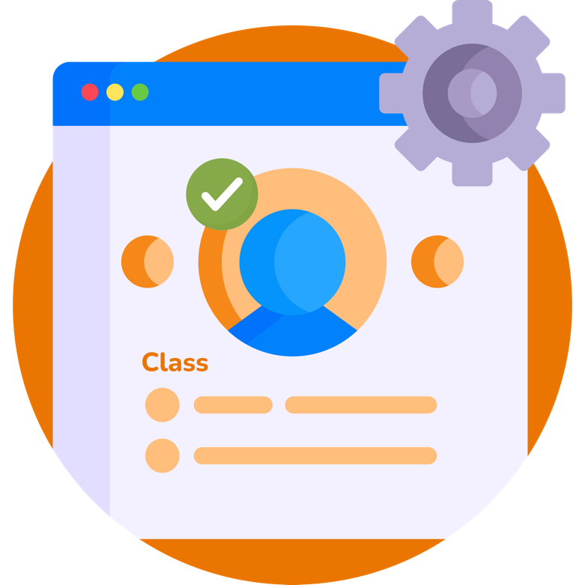
Getting set up is easy & quick.
Simply follow the steps in our simple guide below:
www.famlikids.com/get-started
This link is also available in your teacher portal.
If you ever have any questions or issues, just drop an email at contact@famlikids.com, Famli’s team is here to help!
Notes:
Sign in using our School Login Details:
URL - https://schools.famlikids.com/sign-in
Email –
Password -

