Slide 1
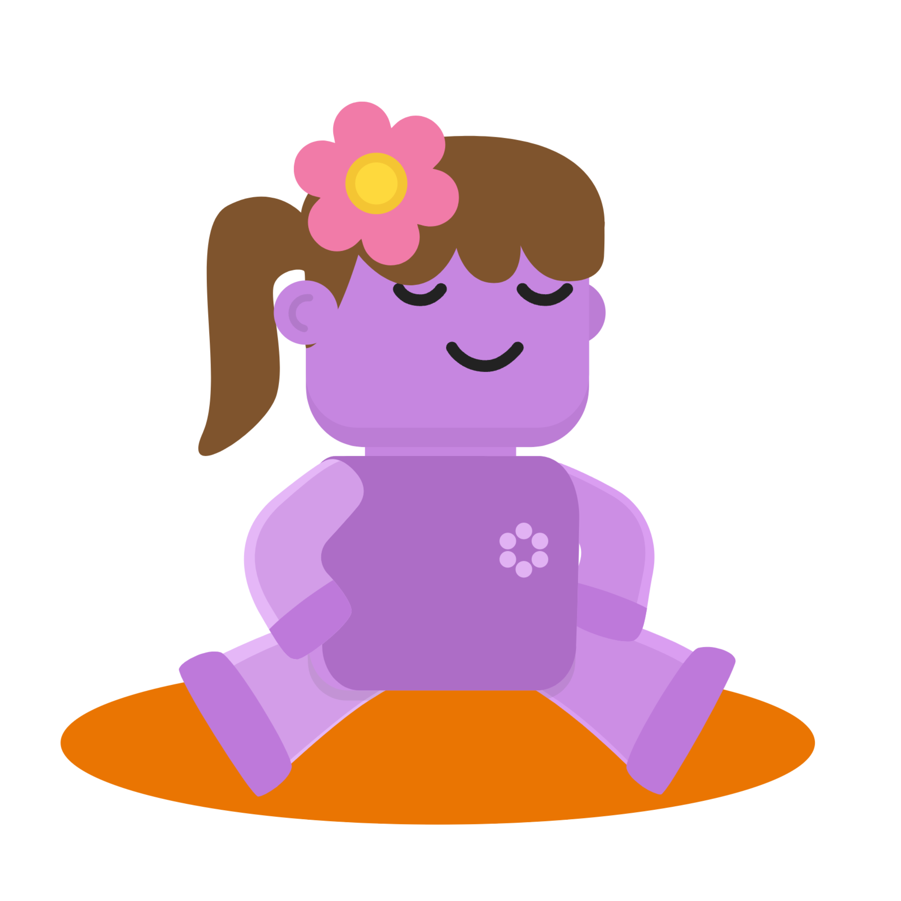
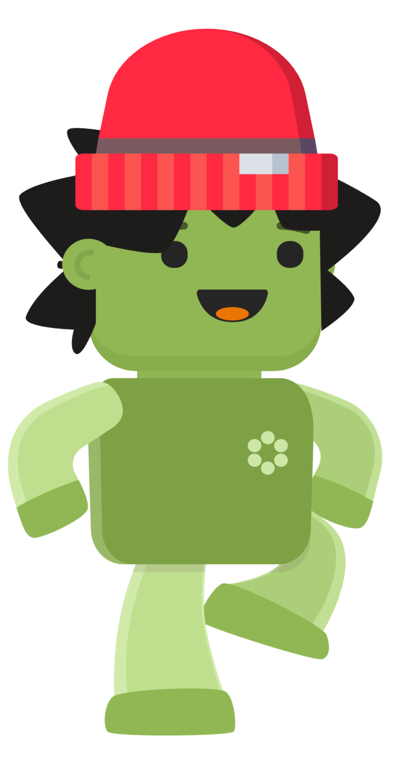
Hi class!
We have
exciting news!

Slide 2
What do you think wellbeing is?

Slide 3
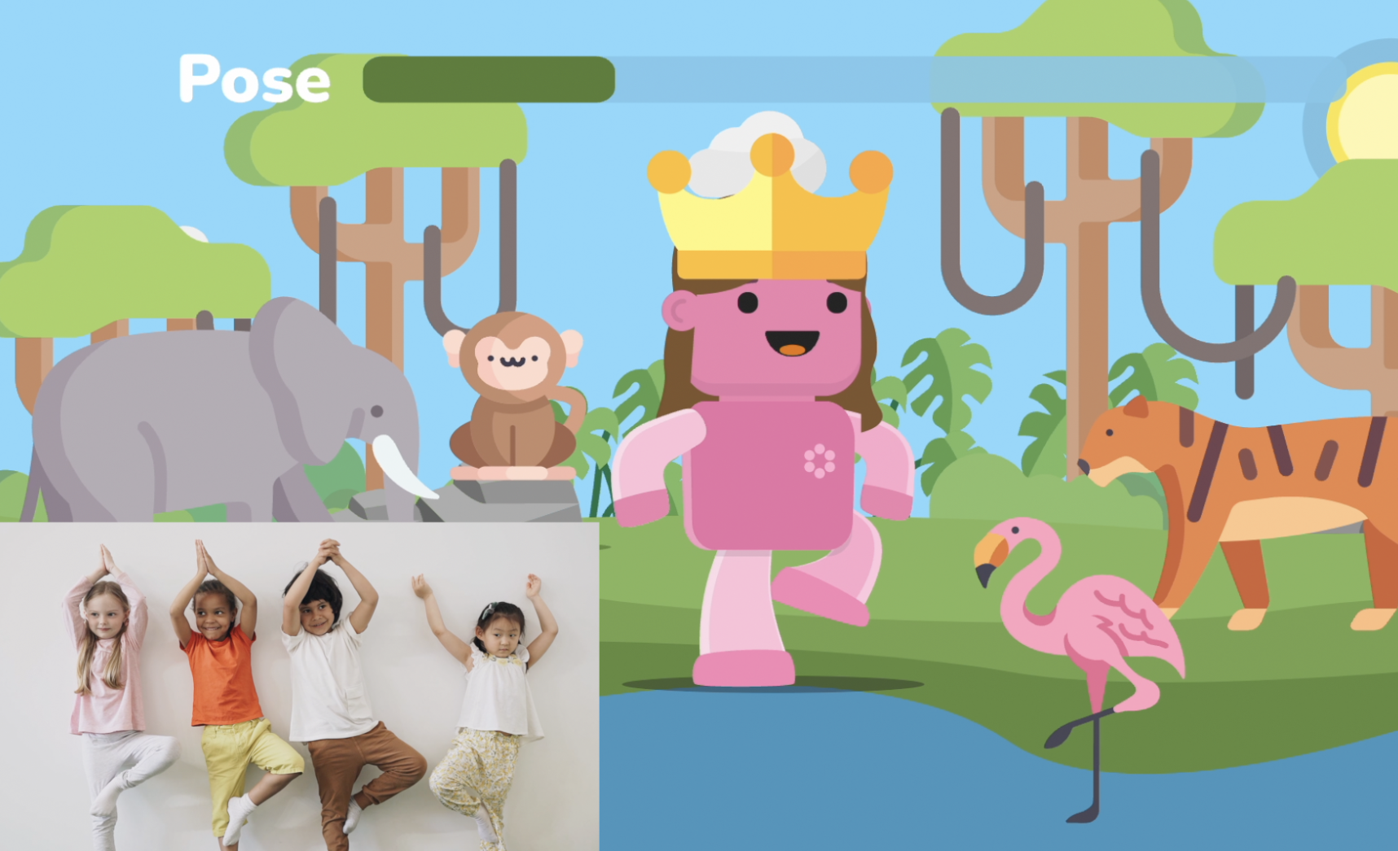
From now, we will all complete fun activities in school and at home to improve wellbeing!

Slide 4
In class, we will be doing wellbeing brain breaks together!
Brain breaks are like mini-adventures for us to move, stretch and relax, to boost our brain and body, so that we can feel good to learn more in class!

Slide 5
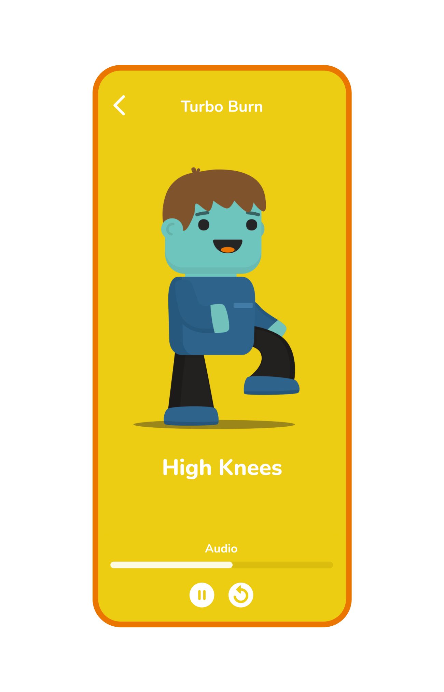
Wellbeing activities are like fun games on your phone and tablet.
They help your body be strong and your mind relax. Ready for some app fun?
At home, you can do fun wellbeing activities too!

Slide 6
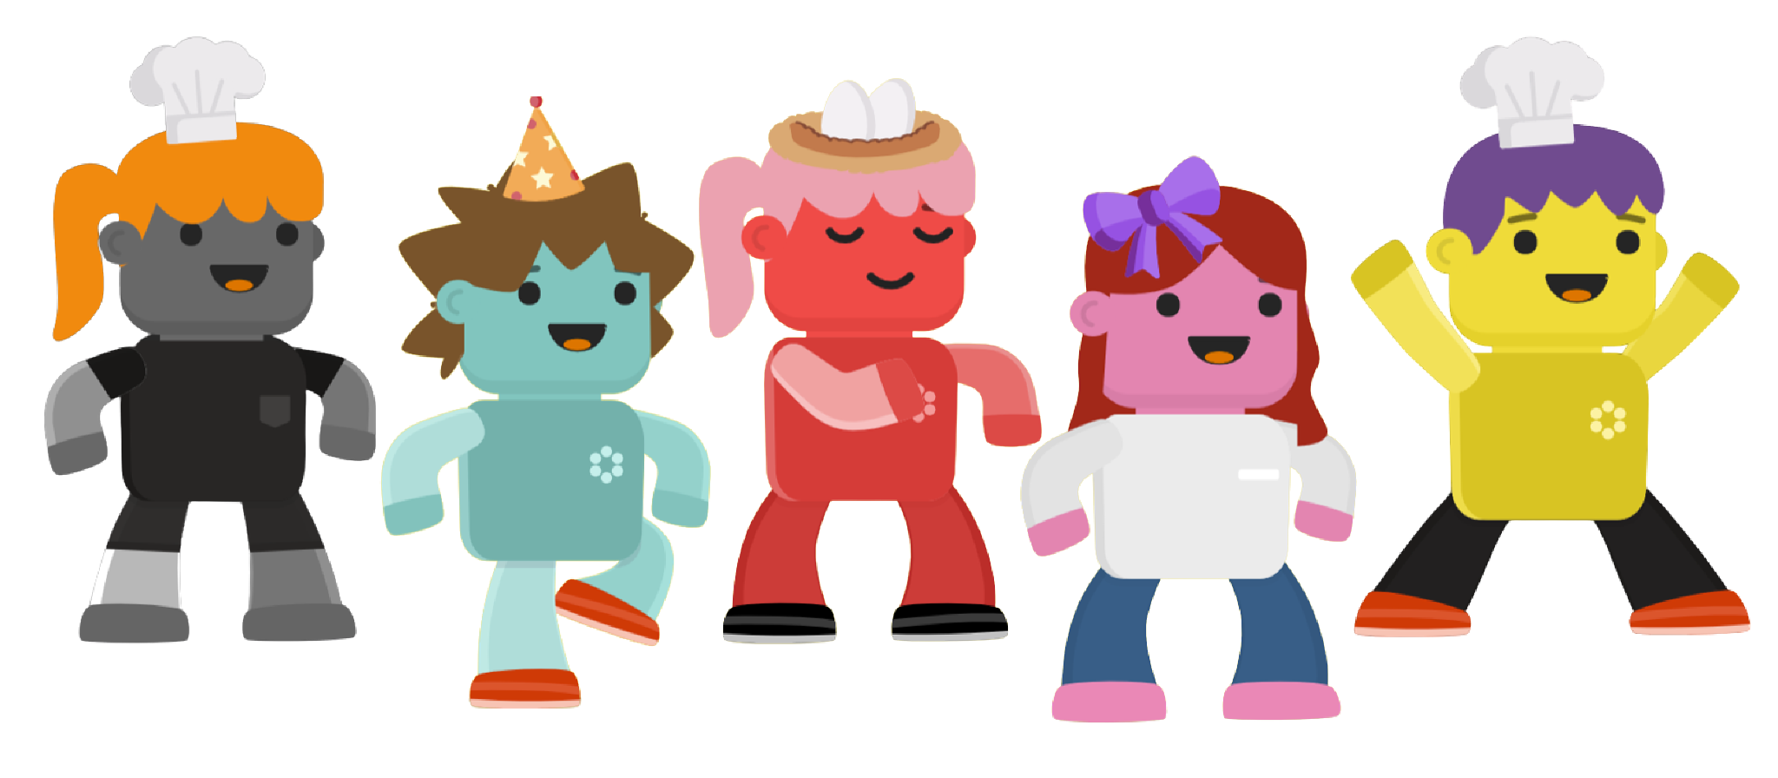
In the Famli app, you will each customise your very own avatars with lots of fun outfits!

Slide 7
Take your paper printout home to download the Famli app and start the fun with your family!
Can’t wait to get started!

